Slide 1
Candidacy Proposal
Noura El Habbal
9//26/19

Slide 2
Introduction

Slide 3
Models
Dexamethasone-induced stress model:
Acute stress becomes chronic with elevated GC levels
Lifestyle stressors like low SES and institutional racism are chronic
Dexamethasone is a potent synthetic GC used therapeutically
Strengths
This model allows us to mimic a chronic stress state
Allows understanding mechanisms of action by which GC affect placental and mammary gland development and function

Slide 4
Models
mTORC1-hyperactivation obesity model:

Slide 5
Specific Aim 1
Determining the effects of glucocorticoid-induced stress on placental transport of nutrients and endocrine function
Aim 1.1: How does maternal GC exposure affect placental development, fetal growth, and fetal survival?
Aim 1.2: How does maternal GC exposure affect the expression of placental nutrient transporters?
Aim 1.3: Is placental mTORC1 signaling altered after maternal GC exposure?
Aim 1.4: How does maternal GC exposure affect placental endocrine function?
Aim 1.5: Is offspring survival, weight, body composition, and insulin sensitivity altered with maternal GC exposure?
Aim 1.6: Does a placental GR-KO model rescue the placental and fetal effects of GC exposure?

Slide 6
Background- Stress
Maternal stressors are part of daily life
Chronic stress causes constant elevations in serum GC levels
GC treatment over 1 or multiple doses is common in high-risk pregnancy

Slide 7
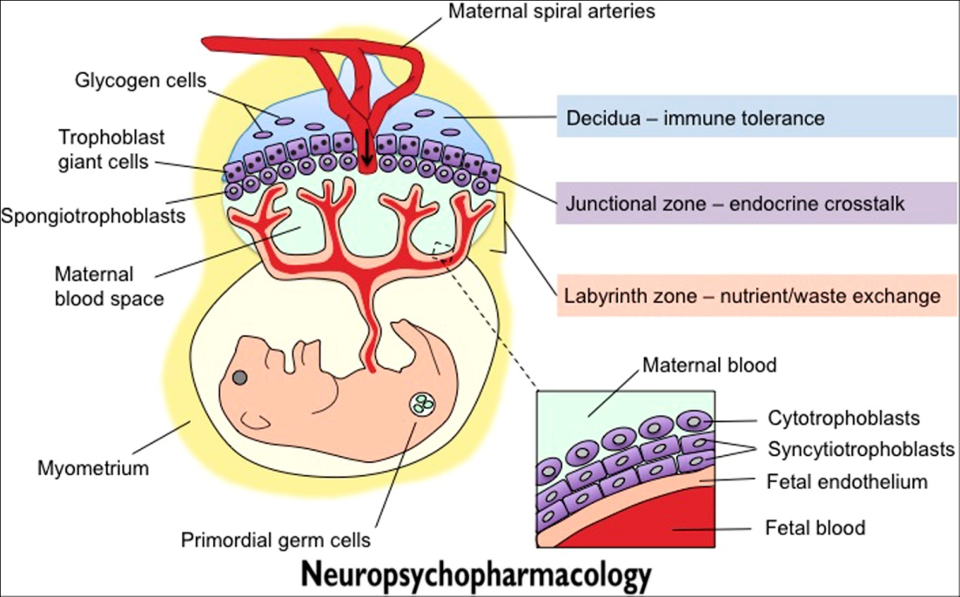
Background- Placenta
Excessive GC levels bypass placental deactivation by HSD11B2 allowing more GC bypass to the fetus
Figure 1: Diagram representing the mouse placental cell types and zones from (Bronson & Bale, 2016)
Neuropsychopharmacology Reviews (2016) 41, 207-218;
doi:10.1038/npp.2015.231

Slide 8
Experimental Design

